Slide 1
Agentic AI
Atul Kahate
https://www.linkedin.com/in/atulkahate/

Slide 2
Module 1: Agentic AI Fundamentals and LLM Access

Slide 3

AI Agent
AI Agent: It is a system that uses AI models to perform tasks
Can perceive its environment, make decisions, and take actions in order to achieve specific goals
Capability | Definition | Examples
Perception | Takes input from the environment | Camera images, text, audio, sensor data, user queries
Reasoning / Decision-making | Decides what to do using rules, logic, or machine learning | Choosing the best move in chess, planning a route, selecting a response
Action | Performs tasks based on decisions | Moving a robot arm, answering a question, executing a command
Learning (optional) | Improves performance over time using feedback | Updating chatbot responses, refining recommendations, improving accuracy

Slide 4
Real World Need of AI Agents
Scale: Too much data, too many decisions – Humans cannot do it
  Bank frauds, Cloud server management
Speed: Decisions must be instant
  Stock trading, Network intrusion detection
24x7 operation: Humans need breaks – systems do not
  Customer support, System monitoring
Complexity: Too many variables
  Supply chain, Smart grids
Adaptability: Changing environment
  Recommendation systems, Cyber attacks
Autonomy: Reduce human dependence
  Auto-healing of cloud infrastructure, Robotic Process Automation (RPA)
Decision support: Not just automation
  Diagnostic agents for doctors, Investment agents for investment managers

Slide 5
Traditional, Generative, Agentic AI
Aspect | Traditional AI | Generative AI | Agentic AI
Core idea | Rules and prediction | Content generation | Autonomous goal execution
Main output | Labels / scores | New content | Actions and outcomes
Creativity | None | High | Moderate–High
Autonomy | Low | Low–Medium | High
Goal handling | Fixed objectives | Prompt-driven | Plans and sub-goals
Interaction | Predefined inputs | Prompts | Continuous loop
Tool usage | Minimal | When prompted | Self-selected and orchestrated
Memory | Minimal | Context-based | Short + long-term
Adaptability | Low | Medium | High
Human involvement | High | Medium | Low
Examples | Spam filter | ChatGPT | Auto-GPT / LangGraph
Use cases | Prediction | Content creation | Automation and decision-making

Slide 6
Agent Types
Type | Core idea | Example
Reactive | Respond | Process an incoming file
Proactive | Plan | Take action toward a goal
Autonomous | Adapt | Independently complete a research task
Feature | Reactive | Proactive | Autonomous
Decision style | Immediate response | Goal-oriented | Self-directed
Planning | No | Yes | Yes
Learning | No | Sometimes | Yes
Human control | High | Medium | Low
Adaptability | Low | Medium | High

Slide 7

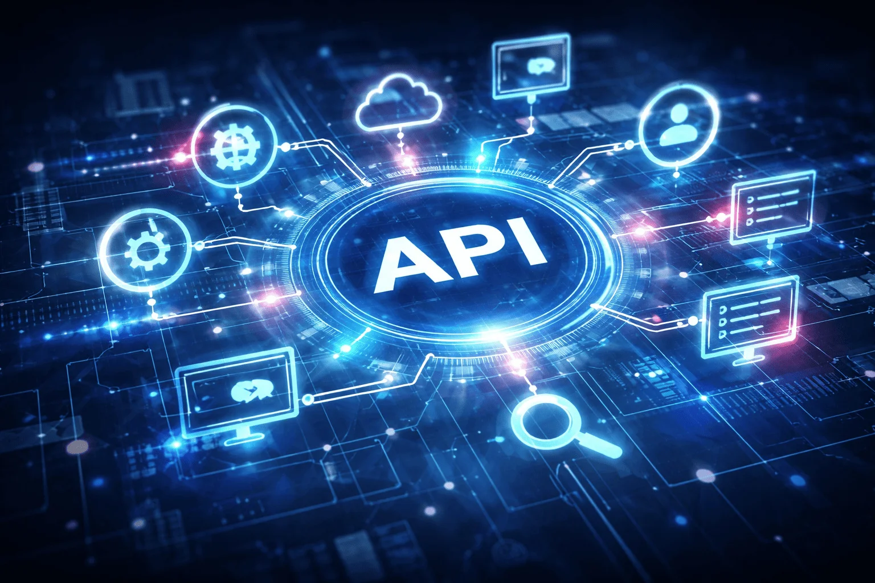



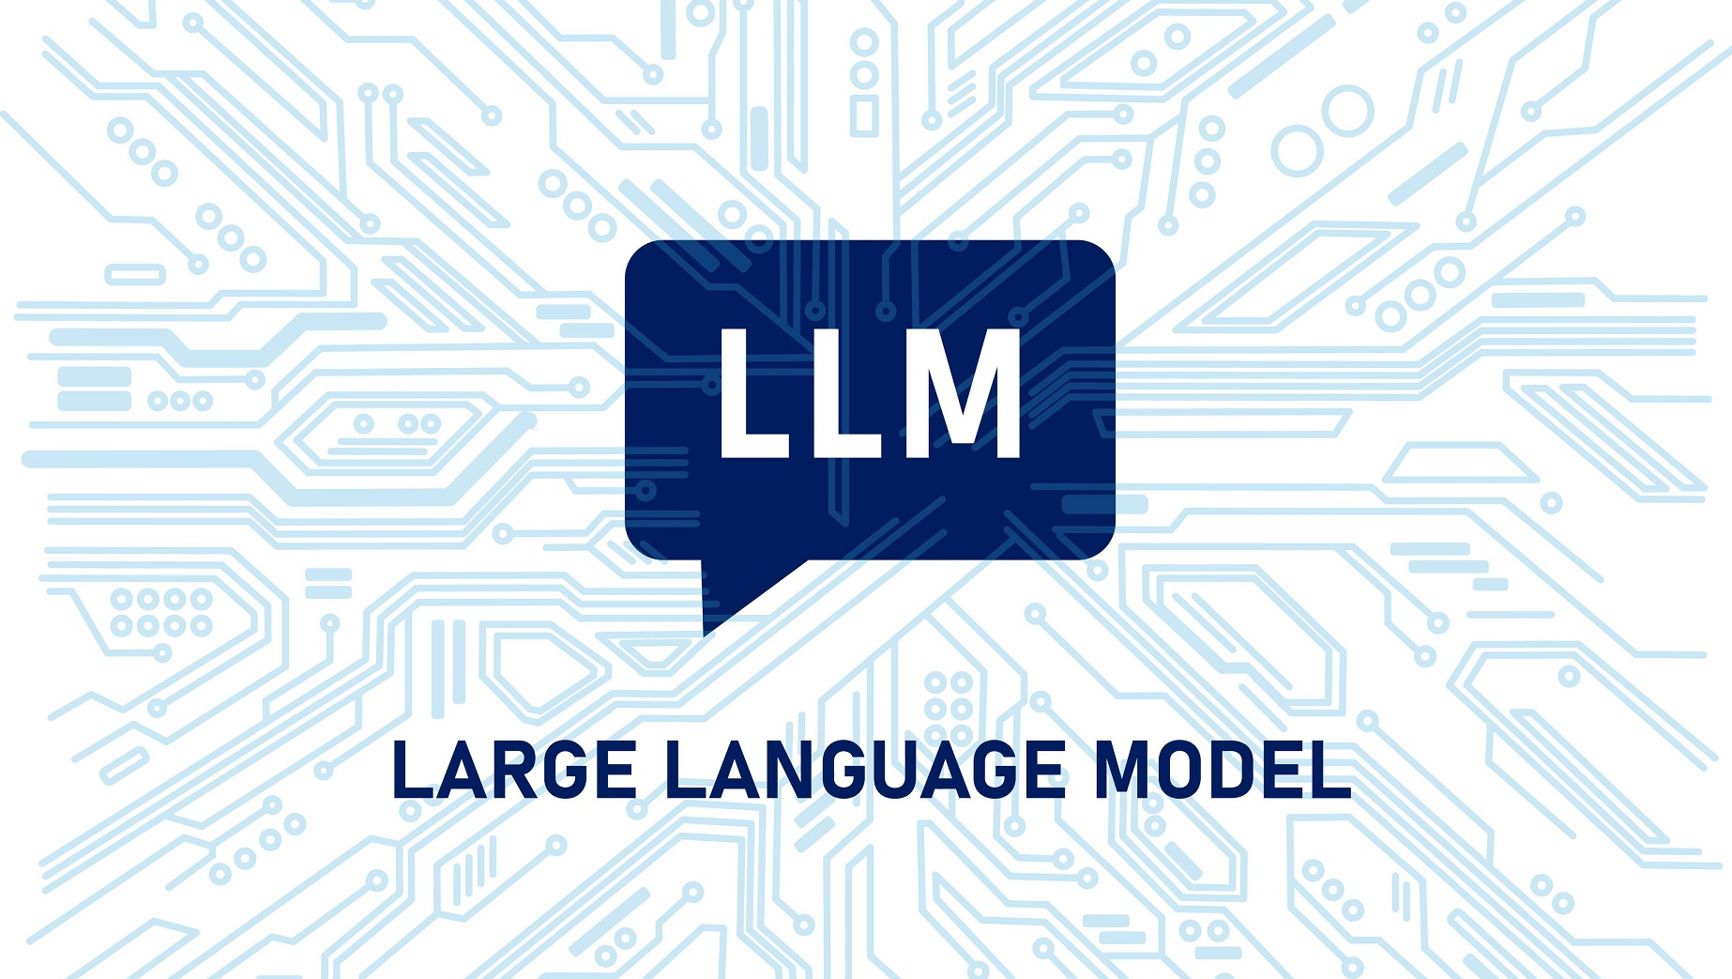




Foundational Components of an AI Agent
MCP
Instructions in a Natural Human Language
Think, Act, Review
Tool Calling
RAG
Guardrails
HITL
Memory
This Photo by Unknown Author is licensed under CC BY-ND

Slide 8
Hands-on: Directly Accessing LLMs
Download and install Python Version 3.12 (https://www.python.org/downloads/)
Download and install VS Code (https://code.visualstudio.com/download)
Create a directory (e.g. c:\code\agenticai_realpage) on your machine
Set up Python in VS Code: Open VS Code and press Ctrl+Shift+P -> Python: Select interpreter -> Select Python that you have installed on your machine
Create a virtual environment in VS Code
  Terminal -> New Terminal -> cd c:\code\agenticai_realpage
  python -m venv myenv
  myenv\Scripts\activate (On Windows) and source myenv/bin/activate (on Linux)
  pip install openai openai-agents
  Later to deactivate: deactivate

Slide 9
Using LLMs: OpenAI
Get an API key: https://platform.openai.com/settings/organization/api-keys
Copy it in .env file
pip install openai dotenv
Run C:\code\agenticai_realpage\module_1\1_openai_basic.py

Slide 10
Building the First Agent
Step 1: Setup and Imports
Code | Explanation
load_dotenv() | Loads API keys from .env file
OpenAI() | Instantiate an object of OpenAI class
from openai import OpenAI
from dotenv import load_dotenv
load_dotenv(override=True)
client = OpenAI()

Slide 11
Building the First Agent
Step 2: Call the LLM
Code | Explanation
create | Create a call to the LLM using the OpenAI Chat Completions API
model | Which LLM to use
messages | system: Set the persona user: A specific question/problem
response | What the LLM returns
response = client.chat.completions.create(
model="gpt-4o-mini",
messages=[
{"role": "system", "content": "You are a helpful assistant"},
{"role": "user", "content": "Explain agentic AI in one paragraph"}
]
)
print(response.choices[0].message.content)

Slide 12
Hugging Face
Open platform for AI model building, training, deployment
“GitHub of modern AI models”
Why Hugging Face?
  Pretrained models – No need to train from scratch
  Standardized APIs – Faster experimentation
  Open ecosystem – Models, Datasets, Demos, Tools
Core components
Component | Purpose
Transformers | State-of-the-art models (BERT, GPT, T5, LLaMA, etc.)
Datasets | Ready-to-use datasets with versioning
Inference API | Run models without infrastructure
Spaces | Share ML demos (Gradio / Streamlit)
Hub | GitHub-like repo for models & datasets

Slide 13
Hugging Face
Typical workflow
  Choose a pretrained model from the Hub
  Load it using Transformers
  (Optional) Fine-tune on your data
  Deploy via API / local / cloud

Slide 14
Using LLMs: Hugging Face
Open-source models
We have full control
Offline / On-prem
No vendor lock-in
Very slow, sometimes
Two options
  Transformers API (Local/GPU/CPU): pip install transformers torch accelerate
    We download and run the model inside our environment
  Hugging Face Interface API (Hosted): pip install huggingface_hub
    Model runs on Hugging Face cloud infrastructure
    Code: module_1\2_hugging_face_local.py
    Will not run, unless we make a payment on Hugging Face site to enable inference endpoints (endpoints.huggingface.co)

Slide 15
Creating a Simple Utility Agent Using OpenAI API (No Frameworks)

Slide 16
Building a Multi-Assistant Agent Step-by-Step
Step 1: Setup and Imports
import asyncio
from agents import Agent, Runner, function_tool
from datetime import datetime
from dotenv import load_dotenv
load_dotenv(override=True)
Code | Explanation
agents | OpenAI Agents SDK
asyncio | For running multiple queries concurrently
function_tool | Decorator to convert functions into agent tools
load_dotenv() | Loads API keys from .env file
Installations
pip install openai-agents dotenv

Slide 17
Building a Multi-Assistant Agent Step-by-Step
Step 2: Create Tools
@function_tool
def get_temperature(city: str) -> str:
"""Returns mock temperature for a city."""
temps = {
"new york": "72°F",
"london": "65°F",
"tokyo": "78°F",
"sydney": "68°F",
"mumbai": "85°F"
}
return temps.get(city.lower(), "70°F")
Code | Explanation
@function_tool | Decorator tells the agent that it is a callable tool
“”” … ‘’’ | Docstring helps the agent decide if and when to use this tool

Slide 18
Building a Multi-Assistant Agent Step-by-Step
Step 2: Create Tools
@function_tool
def get_time(timezone: str) -> str:
"""Returns current time for a timezone."""
return datetime.now().strftime("%I:%M %p")
@function_tool
def calculate(expression: str) -> str:
"""Evaluates a simple math expression."""
try:
result = eval(expression)
return f"{expression} = {result}"
except:
return "Invalid expression"

Slide 19
Building a Multi-Assistant Agent Step-by-Step
Step 3: Create Agent
agent = Agent(
name="QuickAssistant",
model="gpt-4o-mini",
tools=[get_temperature, get_time, calculate],
instructions="You are a helpful assistant. Use tools when needed. Be concise."
)
Code | Explanation
name | Identifies the agent
model | Which LLM to use?
tools | List of available tools
instructions | System prompt

Slide 20
Building a Multi-Assistant Agent Step-by-Step
Step 4: Prepare Test Queries
async def run_agent():
queries = [
"What's the temperature in Tokyo?",
"Calculate 25 * 4 + 10",
"What time is it in New York timezone?",
]
print("Processing queries in parallel...\n")
Code | Explanation
queries | List of queries to be sent to the agent
async def | Run this concurrently
Queries are in natural (human) language
Agent will figure out if and which tool to call

Slide 21
Building a Multi-Assistant Agent Step-by-Step
Step 5: Run Queries Concurrently
# Process all queries concurrently
tasks = [Runner.run(agent, query) for query in queries]
results = await asyncio.gather(*tasks)
Code | Explanation
Runner.run(agent, query) | Executes agent with a query, [ ] creates a list comprehension, i.e. multiple tasks
asyncio.gather() | Runs all tasks simultaneously and waits for all to complete
await | Waits for all results before continuing

Slide 22
Building a Multi-Assistant Agent Step-by-Step
Step 6: Display Results
# Display results
for query, result in zip(queries, results):
print(f"Q: {query}")
print(f"A: {result.final_output}\n")
Code | Explanation
zip() | Pairs each query with its result
result.final_output | Agent’s final answer, after all tool calls

Slide 23
Building a Mult-Assistant Agent Step-by-Step
Step 7: Run the Program
if __name__ == "__main__":
asyncio.run(run_agent())
Code | Explanation
if __name__ == “__main__”: | Standard Python syntax – Only runs if the file is executing directly
asyncio.run() | Starts the async event loop and runs main()

Slide 24
Writing asynchronous Python with asyncio for concurrent LLM calls
AI applications often wait for external services:
  LLM API calls
  Web searches
  Database queries
  MCP tool calls
  File uploads/downloads
Synchronous: Wait for one operation to finish before starting the next
Asynchronous: Start multiple I/O-bound operations concurrently while waiting for responses
Benefits: Better responsiveness and higher throughput
Simple example: Instead of LLM call → wait → Web search → wait → Database query, initiate independent operations concurrently and continue when their results are available

Slide 25
Core asyncio Concepts
Concept | Purpose
async | Define an asynchronous function
await | Wait for an asynchronous operation without blocking
asyncio.run() | Start the event loop
asyncio.gather() | Run multiple tasks concurrently Wait until all responses are received, then return them as a list in the same order as the tasks
create_task() | Schedule a task to run in the background

Slide 26
Basic asyncio Example
import asyncio
import time
# -----------------------------
# Synchronous Version
# -----------------------------
def greet_sync(name):
print(f"{name}: Hello World")
time.sleep(5)
# -----------------------------
# Asynchronous Version
# -----------------------------
async def greet_async(name):
print(f"{name}: Hello World")
await asyncio.sleep(5)
# -----------------------------
# Run Synchronous
# -----------------------------
def run_sync():
print("=== Synchronous ===")
start = time.perf_counter()
greet_sync("Task 1")
greet_sync("Task 2")
greet_sync("Task 3")
end = time.perf_counter()
print(f"Time taken: {end - start:.2f} seconds\n")
# -----------------------------
# Run Asynchronous
# -----------------------------
async def run_async():
print("=== Asynchronous ===")
start = time.perf_counter()
await asyncio.gather(
greet_async("Task 1"),
greet_async("Task 2"),
greet_async("Task 3")
)
end = time.perf_counter()
print(f"Time taken: {end - start:.2f} seconds")
# -----------------------------
# Main
# -----------------------------
run_sync()
asyncio.run(run_async())

Slide 27
Sequential LLM Calls
async def call_llm(prompt):
response = await client.responses.create(
model="gpt-5",
input=prompt
)
return response.output_text
result1 = await call_llm("Summarize...")
result2 = await call_llm("Translate...")
result3 = await call_llm("Classify...")

Slide 28
Concurrent LLM Calls
results = await asyncio.gather(
call_llm("Summarize this article"),
call_llm("Translate to French"),
call_llm("Extract keywords")
)
print(results)
Code: 15_real\sync_vs_async_llm_calls_openai.py and 15_real\sync_vs_async_llm_calls_ollama.py

Slide 29
Module 2: LangChain

Slide 30
LangChain
An open-source framework designed to help developers build applications using large language models (LLMs)
LangChain evolution
Version | Architecture | Status
Early LangChain | LLMChain | Legacy
Intermediate | SequentialChain | Legacy
Modern LangChain | LCEL (Runnable Architecture) | Recommended
Agentic AI | LangGraph | Current for complex workflows

Slide 31
LCEL, Runnable
LCEL (LangChain Expression Language): A declarative way to build AI workflows by connecting components
Runnable = Any component that can take an input and produce an output
Runnable examples
  Prompt: input → formatted prompt
  LLM: prompt → response
  Parser: LLM response → structured output
  Retriever: query → relevant documents
  Function: input → result
Runnables can be connected, combined, and executed as a chain
Pipe operator (|) connects Runnables
  chain = prompt | llm | parser

Slide 32
Example: Prompt | LLM
from langchain_core.prompts import ChatPromptTemplate
from langchain_ollama import ChatOllama
prompt = ChatPromptTemplate.from_template(
"Explain {topic} in simple terms."
)
llm = ChatOllama(model="llama3.2")
chain = prompt | llm
response = chain.invoke(
{"topic":"embeddings"}
)
print(response.content)

Slide 33
Output Parsers
Without a parser: Prompt -> LLM -> AIMessage
Many applications want plain text, JSON, or structured output
  Prompt -> LLM -> AIMessage -> Parser
Code: C:\code\agenticai\14_advanced\05_langchain\output_parsers.py

Slide 34
Prompt Templates
Prompt template: Reusable prompt with placeholders (variables) that are filled at runtime
Example: Instead of
  Explain Artificial Intelligence
  Explain {topic}
C:\code\agenticai\14_advanced\05_langchain\prompt_templates.py

Slide 35
Session Memory
Without memory, every user request is independent
Memory types
Memory Type | Stores | Best For
BufferMemory | Entire conversation | Short conversations
Buffer Window Memory | Last N messages | Chatbots
SummaryMemory | Conversation summary | Long conversations
VectorStoreMemory | Semantic memory | Knowledge retrieval
Entity Memory | Facts about entities | Personal assistants
Combined Memory | Multiple memory types | Enterprise AI

Slide 36
Persistent Memory
Multi-turn conversation: Consists of multiple exchanges between a user and an AI assistant
Session-based memory exists only till the time the application is running
Persistent memory survives application restarts
C:\code\agenticai\14_advanced\05_langchain\persistent_chatbot.py
  config's session_id is a lookup key used before our chain runs, to fetch a SQLChatMessageHistory and turn it into an ordinary "history" list; by the time the LLM is actually called, it receives a normal message list like any other chain invocation — the config/session machinery has already done its job and dropped out

Slide 37


Slide 38


Slide 39


Slide 40


Slide 41


Slide 42


Slide 43


Slide 44


Slide 45


Slide 46


Slide 47
CRUD operations and metadata filtering in ChromaDB
Creating documents
  import chromadb
  client = chromadb.PersistentClient(path="./chroma_db")
  collection = client.get_or_create_collection("employees")
  collection.add(
  ids=["1", "2"],
  documents=[
  "Alice works in Finance.",
  "Bob works in HR."
  ],
  metadatas=[
  {"department": "Finance"},
  {"department": "HR"}
  ]
  )

Slide 48
CRUD operations and metadata filtering in ChromaDB
Reading documents
  result = collection.get(ids=["1"])
  print(result["documents"])
Updating documents
  collection.update(
  ids=["1"],
  documents=["Alice is now the Finance Manager."],
  metadatas=[{"department": "Finance"}]
  )
Deleting documents
  collection.delete(ids=["2"])

Slide 49
ChromaDB - Filtering
results = collection.query(
query_texts=["budget"],
n_results=5,
where={"department": "Finance"}
)
Code: C:\code\agenticai\14_advanced\04_rag\chromadb_search.py and chromadb_crud.py

Slide 50
FAISS
FAISS (Facebook AI Similarity Search): An open-source library developed by Meta for efficient similarity search and clustering of dense vectors (embeddings)
Uses index for very fast search
Why needed?
  Suppose we have 1 million documents and user asks What is machine learning?
  Without FAISS: Query embedding -> Compare with document 1 -> Compare with document 2 -> … -> Compare with document 1000000 (Linear search)
  With FAISS: Query embedding -> FAISS index -> Top 5 results

Slide 51
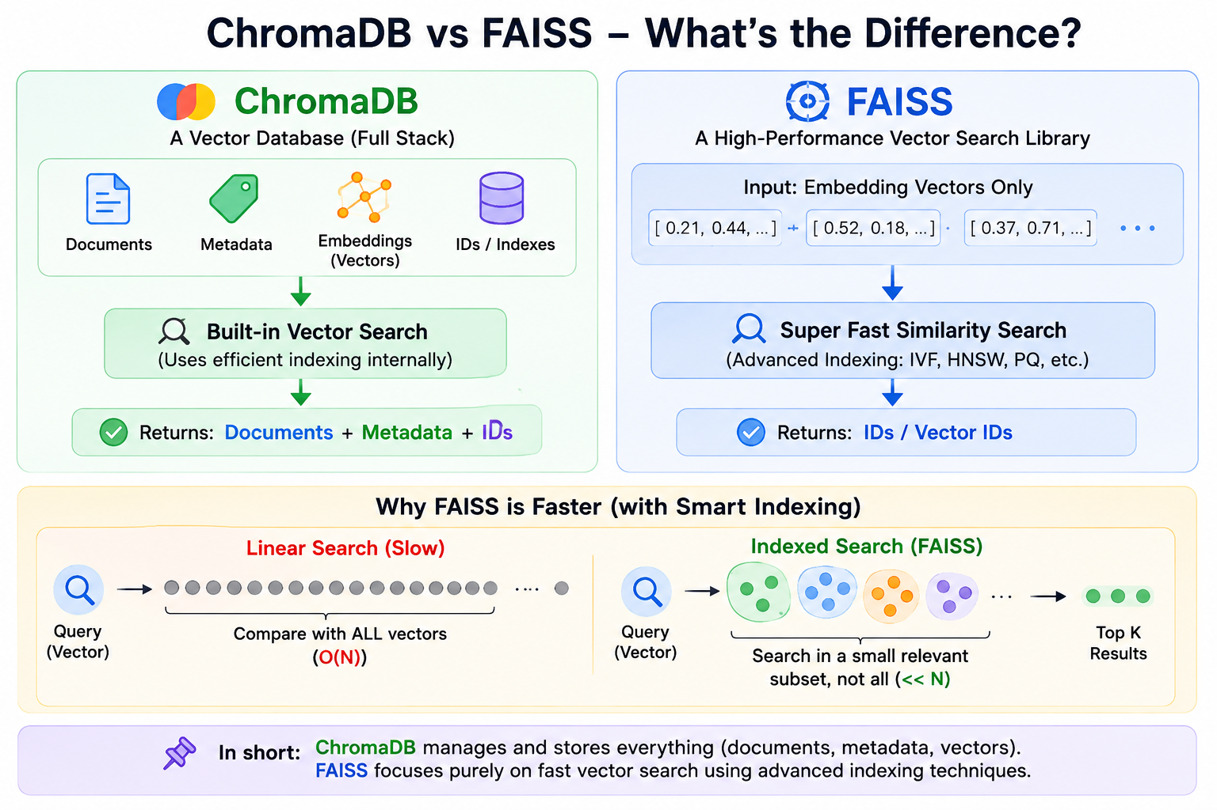

Slide 52
FAISS Index Types
FAISS provides multiple indexing algorithms because different applications have different requirements
Feature | Flat L2 | IVF (Inverted File) | HNSW
Search Type | Exact | Approximate | Approximate
Accuracy | ⭐⭐⭐⭐⭐ | ⭐⭐⭐⭐ | ⭐⭐⭐⭐⭐
Search Speed | Slow | Fast | Very Fast
Memory Usage | High | Medium | High
Training Required | No | Yes | No
Best For | Small datasets | Large datasets | Real-time applications
How works | Stores all vectors Computes distance between query vector and every vector Returns nearest neighbours | Clusters vectors Finds the closest cluster Searches only inside the cluster | Builds a graph where every vector connects to nearby vectors Instead of scanning vectors, the search navigates through the graph

Slide 53
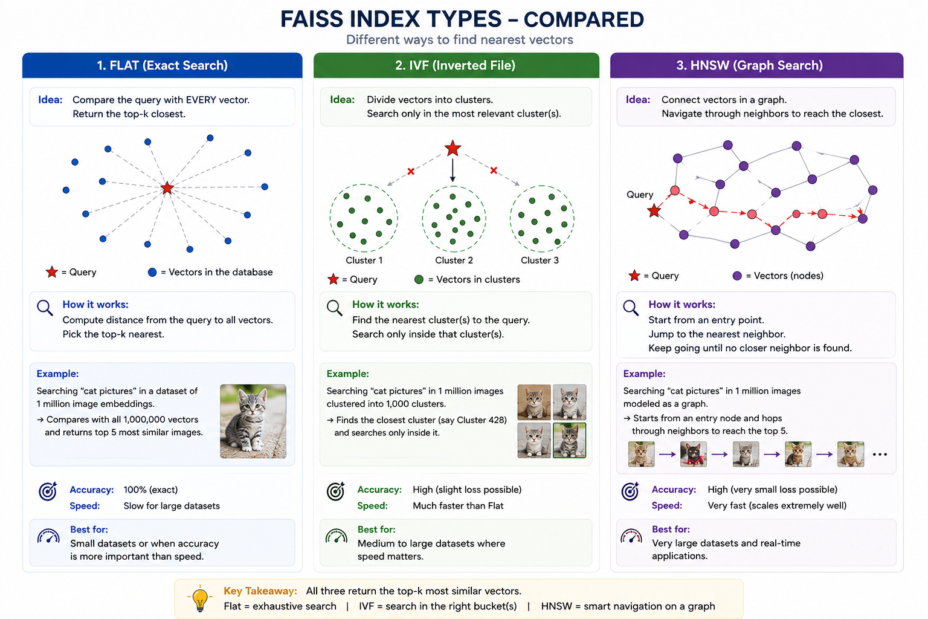

Slide 54
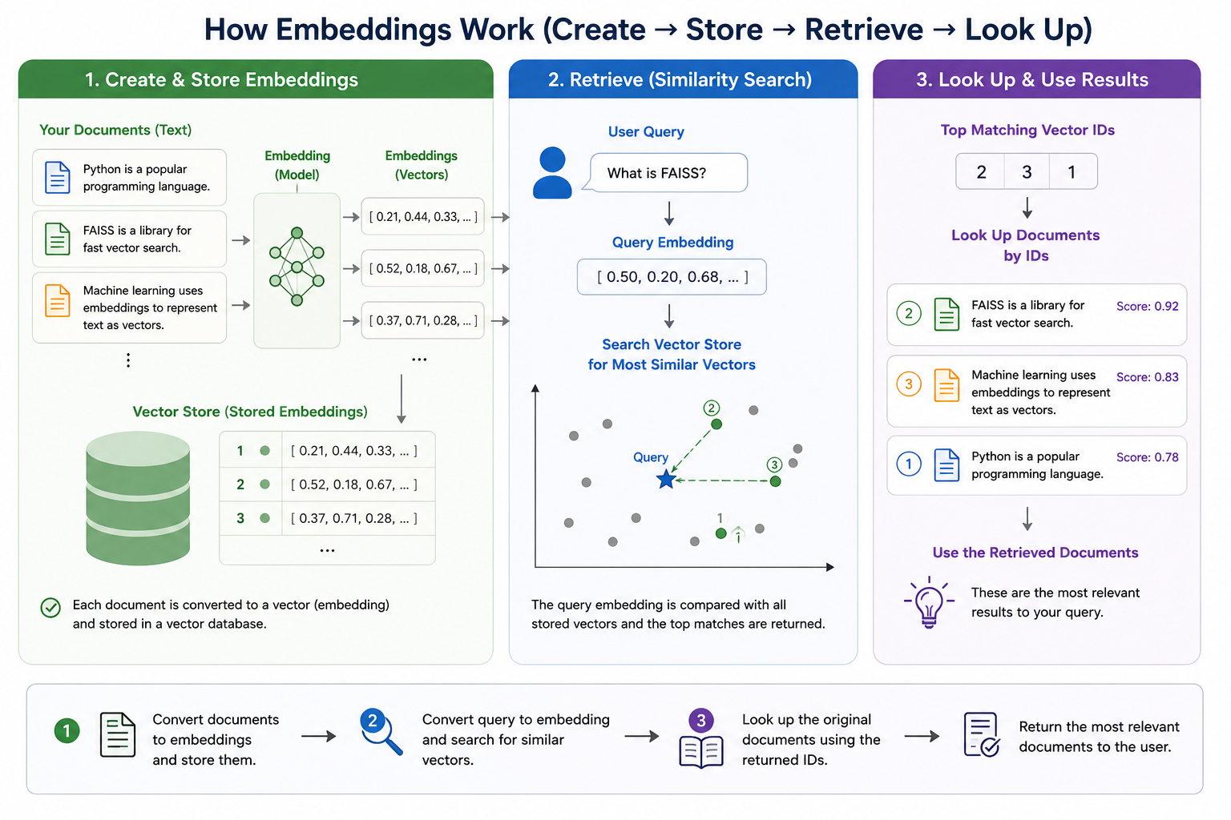
14_advanced\04_rag\faiss_search.py

Slide 55
Nearest-neighbour retrieval: understanding similarity metrics (cosine, L2, dot product)
Common similarity metrics
Metric | Measures | Best Value
Cosine Similarity | Angle between vectors | Larger
L2 Distance (Euclidean) | Straight-line distance | Smaller
Dot Product | Alignment and magnitude | Larger

Slide 56
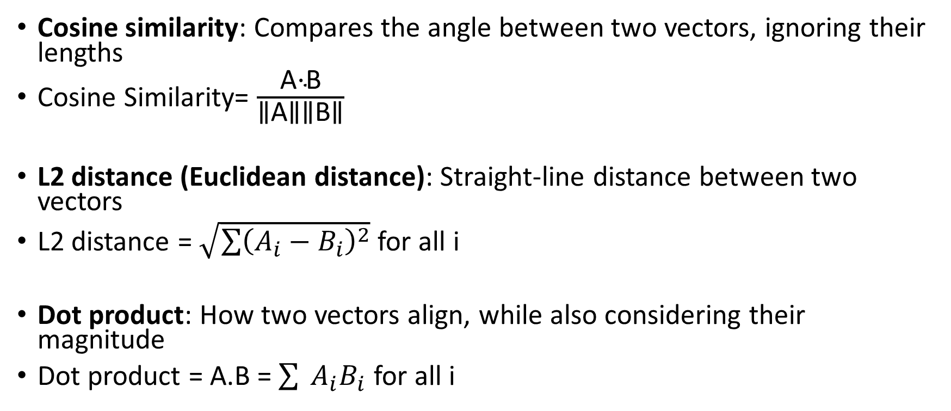
Formulae
Cosine similarity: Compares the angle between two vectors, ignoring their lengths
Cosine Similarity= $\frac{\text{A⋅B​}}{\text{∥A∥∥B∥}}$
L2 distance (Euclidean distance): Straight-line distance between two vectors
L2 distance = $\sqrt{\sum{{\left(A_{i}−B_{i}\right)}^{2}}}$ for all i
Dot product:​ How two vectors align, while also considering their magnitude
Dot product = A.B = $\sum{ \left.A_{i}B_{i}\right.}$ for all i

Slide 57
ChromaDB versus FAISS – Benchmarking
Number of Vectors | ChromaDB | FAISS
10K | 5–10 ms | 2–5 ms
100K | 20–50 ms | 5–15 ms
1 Million | 100–500 ms | 20–80 ms
10 Million | Seconds | <200 ms

Slide 58
Document Loaders
Document Loader: Responsible for reading data from a source and converting it into LangChain Document objects
Every RAG application has this
  Data Source -> Document Loader -> Document Objects -> Text Splitter -> Embeddings -> Vector Database -> Retriever -> LLM
Real world applications use PDF, MS-Word, HTML, CSV, Excel, etc
One format = One loader
Example
  from langchain_community.document_loaders import PyPDFLoader
  loader = PyPDFLoader("banking.pdf")
  documents = loader.load()
Each page = One document

Slide 59
Text Splitters
Splitting documents before embedding them into a vector database for RAG
RecursiveCharacterTextSplitter: Instead of cutting every N characters, it tries to split intelligently in this order
  Paragraph -> New line -> Sentence -> Space -> Character
  Example text
    Artificial Intelligence is changing the world.
    Machine Learning is one branch of AI.
    Deep Learning is a subset of Machine Learning.
    Neural Networks are inspired by the human brain.
  Suppose chunk size = 80
  First attempt: Paragraph separator – Too large
  Second attempt: New line separator – Result: 4 chunks – Preserves complete sentences
SemanticChunker: Uses meaning
  Instead of How many characters, asks Does the topic change here?
  Computes embeddings and decides
C:\code\agenticai\14_advanced\05_langchain\text_splitters.py

Slide 60
Building a RAG pipeline
Documents (PDF, Word, Web, CSV, Database) → Document Loader → Raw Document Objects → Text Splitter → Small Text Chunks → Embedding Model → Embeddings (Vector Representations) → Vector Database (Chroma / FAISS / Pinecone) ← User Question → Question Embedding → Retriever (Similarity Search) → Top-K Relevant Chunks → Prompt (Context + User Question) → LLM / Generator → Final Answer
C:\code\agenticai\14_advanced\05_langchain\rag_pipeline.py

Slide 61
Retrievers
Retriever: Responsible for finding the most relevant documents for a user's query
Instead of sending every document to the LLM, the retriever selects only the most relevant ones
Knowledge Base → Document Loader → Text Splitter → Embedding Model → Vector Database ← User Question → Question Embedding → Retriever → Relevant Chunks → Prompt (Context + Question) → LLM → Final Answer
Bridge between the vector database and the LLM
Instead of sending all documents, the retriever selects only the relevant chunks

Slide 62
Retriever Types (C:\code\agenticai\14_advanced\05_langchain\retrievers.py)
Retriever | Purpose
VectorStoreRetriever | Basic similarity search
MultiQueryRetriever | Multiple query reformulations
ContextualCompressionRetriever | Reduce irrelevant text
SelfQueryRetriever | Uses metadata filters
ParentDocumentRetriever | Retrieve larger parent documents
MultiVectorRetriever | Multiple embeddings per document
EnsembleRetriever | Combine multiple retrieval methods

Slide 63
Callbacks
When building an LLM application, we often need to know:
  What prompt was sent?
  Which documents were retrieved?
  How many tokens were used?
  How long did the LLM take?
  Which tool was called?
  Did an error occur?
Callbacks provide visibility into every stage of execution
Callback: A function that automatically executes when a particular event occurs
Example events:
  LLM starts
  LLM finishes
  Retriever starts
  Retriever finishes
  Tool executes
  Chain starts
  Chain ends
  Error occurs
14_advanced\05_langchain\retrievers.py and 14_advanced\05_langchain\langsmith_tracing.py

Slide 64
Chaining Multiple Retrievers
Suppose your organization stores knowledge in multiple locations
  PDF manuals
  Company website
  Notion
  SQL database
  FAQ documents
A single retriever searches only one knowledge source
Multiple retrievers allow searching all sources simultaneously
C:\code\agenticai\14_advanced\05_langchain\combining_retrievers.py

Slide 65
LangServe
LangServe: Official way to turn our LangChain runnables and chains into a REST API
Built on top of FastAPI
Automatically handles the complex parts of deployment, like schema validation, multiple endpoints (/invoke, /batch, /stream), and even a built-in interactive playground
We register our LangChain code and register with a path – LangServe creates
  API endpoints
  Schema (Automatic JSON validation using Pydantic)
  Playground to test the chain

Slide 66
LangServe: How to Use?
Create deployment code and run it: C:\code\agenticai_realpage\module_2\2_langchain_server.py
To test, browser: http://localhost:8000/ask/playground/
Through code: C:\code\agenticai_realpage\module_2\2_langchain_test_server.py
  To run, Terminal -> New Terminal Window and then run it

Slide 67
Build a Q&A Bot from PDFs
Chroma DB, Insurance example: C:\code\agenticai_realpage\module_2\2_langchain_qand_a_bot_chroma.py
Test: Browser - http://localhost:8000/ask/playground/
FAISS: C:\code\agenticai_realpage\module_2\2_langchain_qanda_bot_faiss.py
Test: Browser - http://localhost:8000/ask/playground/
While Chroma manages a directory of files automatically, FAISS typically saves to a single .index file along with a .pkl for the documents
In LangChain, we use save_local and load_local for this

Slide 68
Module 3: LangGraph for Stateful Agents and HITL

Slide 69
LangChain versus LangGraph
Aspect | LangChain | LangGraph
Purpose | Use LLMs as agents with access to external tools (APIs, databases, etc.) | Build complex, stateful, multi-agent applications with LLMs
Workflow type | Simple, single-step or short workflows | Complex, multi-step, long-running workflows
Agents involved | Usually one agent handling requests | Multiple agents collaborating and interacting
State management | Minimal or stateless; memory handled externally | Built-in memory/state tracking across interactions
Dynamic execution | Limited; follows predefined steps | Supports dynamic branching, agent coordination, and runtime decisions
Best for | Chatbots, calculators, document queries | Automation systems, multi-agent orchestration, AI workflows
Learning curve | Easier; basic LLM + tools interface | Steeper; requires understanding of agents, state, and coordination
Relationship | Foundational concepts | Builds on and extends LangChain principles

Slide 70
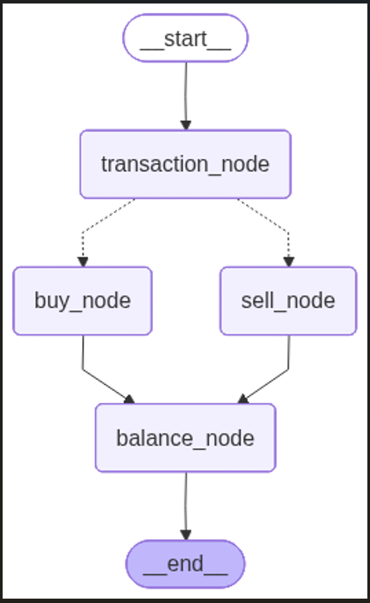
LangGraph:
Key Components
The overall structure that organizes nodes and edges
Graph
Step or operation in the graph – Takes an input state and produces an output state
Node
Edge
Connects two nodes and decides how information flows through them
Data structure that describes the information flowing through the graph at each stage
Final balance
State

Slide 71
First LangGraph Application (3_1_langgraph_basic.py)
Class / Constant | Description
StateGraph | The main class for building graphs in LangGraph
START / END | Special constants representing entry and exit points of the graph
ChatOpenAI | The OpenAI integration from LangChain, used for connecting language models
TypedDict | Used to define the structure and types of data that flows through the graph
from langgraph.graph import StateGraph, START, END
from langchain_openai import ChatOpenAI
from typing import TypedDict
LangGraph uses a state-based architecture. Instead of passing data between individual nodes, all data flows through a shared "state" object. Think of it like a shared clipboard that each step can read from and write to.
user_name: Stores the user's name
greeting: Stores the generated greeting message
messages: Keeps a log of the conversation
class GraphState(TypedDict):
user_name: str
greeting: str
messages: list

Slide 72
First LangGraph Application (3_1_langgraph_basic.py)
def ask_name_node(state: GraphState) -> GraphState:
user_input = input("Bot: What is your name? ")
return {
**state,
"user_name": user_input,
"messages": state.get("messages", []) + [f"User provided name: {user_input}"]
}
Node function 1
Takes the current state as input
Asks user for their name
Returns a new state with updated information
  **state copies all existing state data
  Updates specific fields (user_name, messages)
def greet_user_node(state: GraphState) -> GraphState:
user_name = state.get("user_name", "there")
greeting = f"Hello {user_name}! Nice to meet you."
return {
**state,
"greeting": greeting,
"messages": state.get("messages", []) + [f"Bot: {greeting}"]
}
Node function 2
Reads user_name from the current state
Creates a personalized greeting
Updates state with the greeting and conversation log

Slide 73
First LangGraph Application (3_1_langgraph_basic.py)
def create_greeting_graph():
workflow = StateGraph(GraphState)
# Add nodes
workflow.add_node("ask_name", ask_name_node)
workflow.add_node("greet_user", greet_user_node)
# Add edges
workflow.add_edge(START, "ask_name")
workflow.add_edge("ask_name", "greet_user")
workflow.add_edge("greet_user", END)
return workflow.compile()
Graph Construction
Structure: START → ask_name → greet_user → END
Nodes represent processing steps (functions)
Edges define the flow between steps
START is where execution begins
END is where execution terminates
.compile() creates the executable graph

Slide 74
First LangGraph Application (3_1_langgraph_basic.py)
# Create the graph
app = create_greeting_graph()
# Initialize state
initial_state = GraphState(
user_name="",
greeting="",
messages=[]
)
# Run the graph
final_state = app.invoke(initial_state)
Execution
Initialize: Create empty state
Invoke: Start execution at START node
Flow: State passes through: ask_name → greet_user
Result: Get final state with all accumulated data

Slide 75
LangGraph Reducer
(3_2_langgraph_without_reducer.py, 3_3_langgraph_without_reducer.py)
Reducer: Defines how state values are merged when multiple nodes write to the same key
Answers the question: “When many agents update the same state, how do we combine it?”
With reducer
def add_messages(old: List[str], new: List[str]) -> List[str]:
return old + new # This is the reducer function
class State(TypedDict):
messages: Annotated[List[str], add_messages]
def agent_a(state: State):
return {"messages": ["Hello from Agent A"]} # Not lost
def agent_b(state: State):
return {"messages": ["Hello from Agent B"]}
Without reducer
class State(TypedDict):
messages: List[str]
def agent_a(state: State):
return {"messages": ["Hello from Agent A"]}
def agent_b(state: State):
return {"messages": ["Hello from Agent B"]}

Slide 76
Using Reducer with LLM
Check the product return policy of two e-commerce websites
Use a reducer to combine the outputs of the two
Create two agents and run them in parallel
Code: 3_4_langgraph_reducer_return_policy.py

Slide 77
Cycles/Loops
Cycle/Loop: Occurs when a graph returns to a previously executed node instead of always moving forward
Examples:
  Search until enough documents are found
  Retry failed API calls
  Improve generated code
  Refine an answer
Created using conditional edges
C:\code\agenticai\14_advanced\08_langgraph_cycles_HIL_persistence\order_processing_state_machine.py

Slide 78
Human In the Loop (HIL)
Human-in-the-Loop (HIL): The graph pauses execution at specific points, allowing a human to inspect, approve, modify, or reject the workflow before it continues
Examples: Loan approvals, Large bank transfers, Medical recommendations, Legal document generation, Contract signing
Implemented using the LangGraph interrupt() command
  If a ticket is auto resolved -> Skip to finalize, no HITL
  If a ticket resolution says needs_review -> Go to human_approval () function
    This function calls interrupt() command -> Freezes everything -> Hands control back to the user and asks in the console: Approve/Edit/Escalate -> Whatever the user types becomes the node’s return value and it unfreezes
  To ensure the interrupt does not cause LangGraph to forget what had happened, we need memory saver checkpointer
C:\code\agenticai\15_real\support_ticketing_agent_hitl.py

Slide 79
Checkpointers
Checkpointer: A component that saves the current state of a LangGraph workflow so execution can continue later instead of starting over
Contains
  Current graph state
  Current node
  Conversation history
  Variables
  Thread identifier
  Pending interrupts
Checkpointer (Where was the agent?) ≠ Memory (What does the agent know?)
C:\code\agenticai\14_advanced\08_langgraph_cycles_HIL_persistence\sqlite_checkpointing_crash_recovery.py

Slide 80
Guardrails
A safety control mechanism that ensures the model operates within defined limits by preventing unsafe, harmful, incorrect, off-topic, or policy-violating behavior
Type of Guardrail | Purpose | Examples
Keyword / Phrase Blocking | Stop harmful or restricted words | Block: “bomb”, “hack”, “virus”
Input Validation | Reject malformed, long, or suspicious inputs | Max length, no URLs, no code blocks
Allow-List Topics | Only permit certain categories | Only allow: product queries, reviews
Semantic Safety (Embedding-Based) | Detect harmful intent beyond keywords | Check if query is similar to “harm”, “illegal activity”
Prompt Guardrails | Restrict what the LLM is allowed to answer | “Use context only”, “Don’t produce code”
Output Filtering | Post-process model output before showing it | Remove sensitive data, profanity
Tool-Use Guardrails | Restrict which tools the agent is allowed to call | Don't allow web search for medical queries
Rate and Abuse Control | Prevent spam or automated misuse | Throttling, user authentication
Content Policy Enforcement | Ensure model answers follow rules | Safety, factuality, privacy constraints
Hallucination Reduction | Prevent LLM from making up facts | Use retrieval-only answers; citations required
Business-Logic Guardrails | Enforce domain rules | “Don’t show pricing for unlaunched products”

Slide 81
Module 4: OpenAI Agents SDK
Refer to the main PPT for discussion

Slide 82
Tool-Augmented Research Agent
Use SERP API for researching on the specified topic
If the topic is recent, try date-based search
For specific topics, retrieve more details using Python BeautifulSoup library
C:\code\agenticai\15_real\research_agent_tools.py

Slide 83
Agent Lifecycle Hooks
Lifecycle hooks allow you to execute custom code automatically at different stages of an agent's execution
  Logging and Monitoring
  Debugging
  Performance measurement
  Analytics
  Cost tracking
RunHooks: Global, AgentHooks: Agent-specific
Code: C:\code\agenticai\15_real\observability_logging_tracking.py
Callback | When It Executes
on_agent_start() | Agent begins execution
on_llm_start() | Before sending request to LLM
on_llm_end() | After receiving LLM response
on_tool_start() | Before calling a tool
on_tool_end() | After tool execution
on_handoff() | Before switching to another agent
on_agent_end() | Final output generated

Slide 84
Module 5: Agentic RAG Systems

Slide 85
Traditional RAG versus Agentic RAG
Traditional RAG | Agentic RAG
Fixed retrieval pipeline | Intelligent, dynamic workflow
Retrieves documents once | Can retrieve multiple times as needed
Single LLM call | Multiple reasoning steps
No planning capability | Plans and decides next actions
Limited decision-making | Autonomous decision-making
Uses a predefined sequence | Chooses the best execution path
Simple architecture | Multi-step agent architecture
Best for straightforward Q&A | Best for complex problem solving

Slide 86
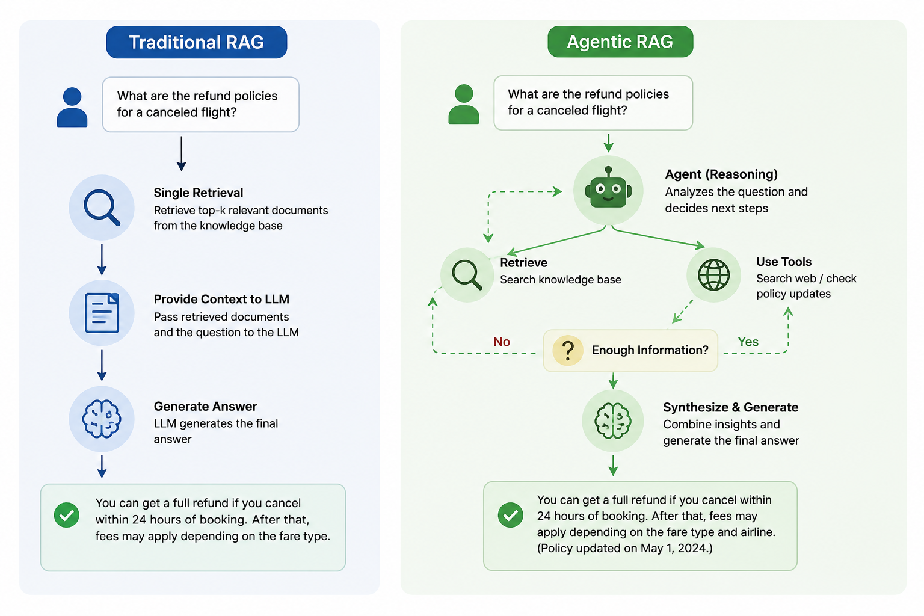
C:\code\agenticai\15_real\traditional_vs_agentic_rag.py

Slide 87
Common Adaptive Strategies (C:\code\agenticai\15_real\adaptive_retrieval_strategies.py)
Strategy | Description
Skip Retrieval | Answer directly if existing knowledge is sufficient
Single Retrieval | Retrieve once for simple factual questions
Iterative Retrieval | Retrieve additional documents if more information is needed
Query Reformulation | Rewrite the query to improve search accuracy
Multi-Source Retrieval | Combine information from vector databases, SQL databases, APIs, and web search
Tool-Based Retrieval | Choose the most appropriate tool based on the user's request

Slide 88
Cohere
Cohere: AI platform that provides APIs for building applications using Large Language Models (LLMs), Embeddings, Reranking, and Semantic Search
Features
  Produces high-quality vector embeddings
  Improves retrieval accuracy with reranking
  Supports multiple vector databases
  Easy API integration
  Optimized for enterprise search applications

Slide 89
Retrieval + Reasoning
Modern AI applications combine Retrieval (finding relevant information) with Reasoning (analyzing, interpreting, and making decisions) to produce accurate and context-aware responses
  Retrieval provides factual knowledge
  Reasoning uses that knowledge to solve the user's problem
Example: Can I get a ₹50 lakh home loan? My salary is ₹18 lakh/year, I already have a car loan, and my credit score is 760.
  Retrieval: Loan eligibility policy, Current interest rates, Customer profile, Credit score, Existing loans, RBI lending rules
  Reasoning: Calculates Debt-to-Income (DTI) ratio, Checks credit score eligibility, Verifies policy rules, Determines maximum eligible amount, Suggests suitable loan options

Slide 90
Retrieval + Reasoning Example
Code: C:\code\agenticai\15_real\cohere_rag_pipeline.py
embed() — turns text into 1536-dim vectors (embed-v4.0)
rerank() — narrows all 324 FAQs down to the top-3 most relevant to the query (rerank-v3.5) — correctly surfaced the 3 refund-related entries for "How do I get my money back for an order?"
chat() — generates the final answer, passing the reranked FAQs straight in via documents= — Cohere's chat endpoint handles the grounding/context-stuffing natively, unlike OpenAI where you build that prompt yourself

Slide 91
Market Research Assistant using RAG
Code: C:\code\agenticai\15_real\market_research_assistant_rag.py
  Load competitor data, industry trends, our own product positioning into RAG
  Agent is given tools: search market knowledgebase, get pricing benchmark, search web
  Summarize findings

Slide 92
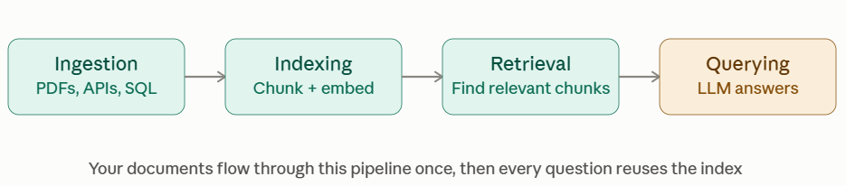
LlamaIndex
LlamaIndex: A framework designed to connect Large Language Models (LLMs) with your organization's private data
Simplifies building Retrieval-Augmented Generation (RAG) applications by handling data ingestion, indexing, retrieval, and querying
Much more than a simple vector database such as Chroma
  Vector DBs only store and search embeddings; LlamaIndex also parses documents, chunks them, and routes queries to the right source
Example: Ask a question about your company's 500-page policy manual, and LlamaIndex finds and feeds the LLM just the relevant paragraphs

Slide 93
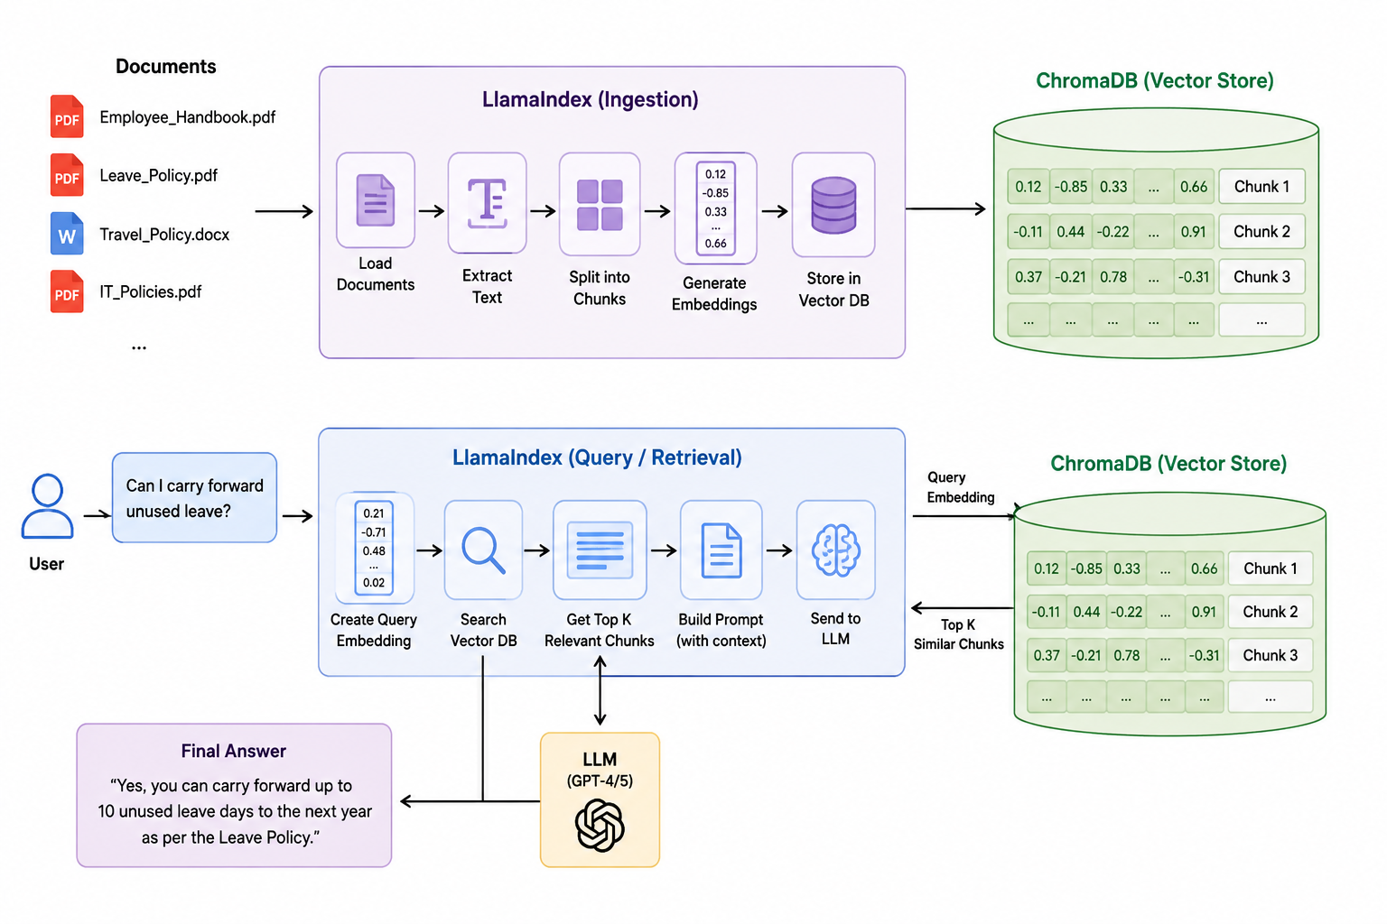

Slide 94
LlamaIndex
C:\code\agenticai\15_real\grounded_generation_llamaindex.py
SimpleDirectoryReader
  Reads documents from disk
  Supports PDFs, Markdown, Word, HTML, etc.
  Converts them into LlamaIndex Document objects
VectorStoreIndex
  Splits documents into chunks
  Creates embeddings
  Builds a searchable vector index
  Enables semantic retrieval
CitationQueryEngine
  Retrieves the most relevant document chunks
  Sends them to the LLM as context
  Produces answers with inline citations (e.g., [1], [2])
  Makes responses traceable and verifiable

Slide 95
Module 6: Agent Memory, State, and Context Management

Slide 96
Memory Types
Memory Type | Purpose | Lifetime | Example
Short-Term Memory (Working Memory) | Current conversation context | Minutes / Session | Previous chat messages
Long-Term Memory | Persistent user knowledge | Days to Years | User preferences, profile
External Memory | Information stored outside the agent | Persistent | ChromaDB, SQL, Redis
Semantic Memory | Facts and knowledge | Persistent | "Python is your preferred language."
Episodic Memory | Past interactions and experiences | Persistent | Previous customer support sessions
Procedural Memory | Learned procedures and workflows | Persistent | Steps to deploy an application
Why memory?
  Maintain conversation context
  Remember user preferences
  Recall previous tasks
  Personalize responses
  Reduce repeated questions
  Support long-running workflows

Slide 97
Memory Examples
First run C:\code\agenticai\15_real\agent_memory_short_term_langgraph.py
Now run C:\code\agenticai\15_real\agent_memory_dynamic_session_id_langgraph.py -> Change is, we accept user id from user and that is our session ID
Now run C:\code\agenticai\15_real\agent_memory_short_to_long_term_langgraph.py and C:\code\agenticai\15_real\agent_memory_short_to_external_sqlite_langgraph.py -> Saving short term memory into local/external long term memory
Now run C:\code\agenticai\15_real\agent_memory_episodic_langgraph.py, C:\code\agenticai\15_real\agent_memory_procedural_langgraph.py, C:\code\agenticai\15_real\agent_memory_semantic_langgraph.py

Slide 98
State Schema Design
State: A structured data object that stores all the information an agent needs while executing a workflow
As the workflow progresses, each node reads the current state and updates it
Initial State -> Agent Node A (Read and Update) -> Updated State -> Agent Node B (Read and Update) -> Updated State -> Final Response
Field | Purpose
messages | Conversation history
user_query | Current user request
retrieved_docs | Retrieved knowledge
tool_results | Results returned by tools
reasoning | Intermediate reasoning
final_answer | Final response
user_profile | User preferences and profile
status | Current workflow status

Slide 99
Example of State Schema
User asks: Am I eligible for a ₹50 lakh home loan?
Initial State
messages
user_query
Everything else empty
After retrieval
messages
user_query
retrieved_docs
After tool execution
messages
user_query
retrieved_docs
tool_results
After reasoning
messages
user_query
retrieved_docs
tool_results
reasoning
Final State
messages
user_query
retrieved_docs
tool_results
reasoning
Final_answer
Agent State
  messages
  user_query
  retrieved_docs
  tool_results
  reasoning
  final_answer

Slide 100
Context Propagation and Trim Strategies
Context propagation: Passing relevant information from one step (or agent) to the next so that the workflow maintains continuity and makes informed decisions
Example: User asks - Can I get a ₹50 lakh home loan?
  Step 1: Query
  Step 2: Query + Retrieved policies
  Step 3: Query + Retrieved policies + Credit score
  Step 4: Query + Retrieved policies + Credit score + Reasoning -> Final answer
Why trim context?
  LLM has a limited context window
  Techniques: Next slide

Slide 101
Context Trimming Strategies
Code: C:\code\agenticai\15_real\context_management_strategies.py
Strategy | Description | Best For
Sliding Window | Keep only the latest N messages | Chatbots
Summarization | Replace older conversations with a summary | Long conversations
Semantic Retrieval | Retrieve only relevant past memories | Long-term memory
Token-Based Trimming | Remove oldest content when token limit is reached | Production systems
Priority-Based Context | Always keep critical information, discard less important details | Enterprise agents

Slide 102
Human In The Loop (HITL) UX
A good HITL experience should provide
  Clear AI recommendation
  Supporting evidence
  Confidence score
  Retrieved documents
  Reasoning summary
  Action buttons
Code: C:\code\agenticai\15_real\support_ticketing_agent_hitl.py

Slide 103
Code Example
Long term memory (in ChromaDB) using LangChain: C:\code\agenticai\15_real\langchain_long_term_memory_rag.py

Slide 104
Module 7: Evaluation Frameworks

Slide 105
Need for Evaluation in RAG and Agent Systems
Correctness – Wrong retrieval/reasoning → wrong answers (e.g., outdated medical advice stated confidently)
Retrieval quality – Bad retrieval = bad generation, GIGO (Garbage In, Garbage Out)
Hallucination and Groundedness – Checks that answers are actually supported by retrieved docs, not fabricated
Agentic reasoning – Did the agent pick the right tool, reason correctly, and finish the task? (e.g., search → compare → book → confirm)
Trust and adoption – Users need consistent, explainable, accurate outputs to trust the system
Continuous improvement – Evaluation catches drift, compares versions, and tunes pipelines/prompts over time

Slide 106
RAGAS
Retrieval-Augmented Generation Assessment
Open-source framework to evaluate RAG systems — no manual labeling needed
Scores both retrieval and generation, not just the final answer
Why needed? Traditional eval only checks the final answer, RAGAS asks:
  Was the right info retrieved?
  Was it relevant?
  Is the answer grounded in it?
  Does the answer actually address the question?

Slide 107
RAGAS Metrics
Metric | Measures | Evaluated Against | Example
Faithfulness | Are answer claims supported? | Retrieved Context | Q: "Capital of France?" → Answer: "Paris, population 10M" — if population isn't in retrieved docs, faithfulness score drops
Answer Relevance | Does the answer address the user's question? | Original Question | Q: "How do I reset my password?" → Answer explaining account creation = low relevance
Context Precision | Are the retrieved chunks relevant? | Ground Truth | Q: "Symptoms of flu?" → 5 chunks retrieved, only 2 are actually about flu symptoms = low precision
Context Recall | Was all necessary information retrieved? | Ground Truth | Ground truth needs 4 key facts to answer fully; only 2 were retrieved = low recall

Slide 108
What RAGAS Does Internally
Metric | What RAGAS Does
Faithfulness | Breaks the answer into individual factual claims (atomic statements), then checks each one against the retrieved context to see if it's actually supported
Answer Relevance | Takes the generated answer and asks an LLM to "guess back" what question it is answering (proxy questions), then compares those to the original question using embedding similarity
Context Precision | Splits the retrieved context into chunks, evaluates each chunk individually as relevant or not, then calculates what fraction of retrieved chunks were actually useful
Context Recall | Compares the retrieved context against the ground-truth answer to check whether every fact needed to fully answer the question was actually retrieved

Slide 109
RAGAS Metrics Example
Suppose the question is: A user asks a smart home support chatbot: "How do I reset my Wi-Fi router?“
Note: Remember this key distinction
  Precision → "Of what you retrieved, how much was useful?"
  Recall → "Of what was needed, how much did you retrieve?"

Slide 110
Faithfulness
Are the answer's claims actually backed by the retrieved context?
Answer generated by RAG/LLM: "Hold the reset button for 10 seconds, the light will blink, then wait exactly 2 minutes for it to reboot"
Broken into 3 claims:
  S1: Hold reset button for 10 seconds
  S2: Light will blink
  S3: Wait 2 minutes for reboot
Retrieved context: "Press and hold the reset button on the back of the router for 10 seconds. The status light will blink to confirm the reset. The router will restart automatically."
  S1 ✅ — confirmed
  S2 ✅ — confirmed
  S3 ❌ — context says it restarts "automatically," never gives a specific time. The "2 minutes" detail was made up
Score = 2/3 = 0.67 — the answer added a specific-sounding detail that wasn't actually in the source

Slide 111
Answer Relevance
Does the answer actually address what was asked?
How it works
  Take the generated answer
  Ask an LLM: "What question would this answer be a good response to?" → generates 1-3 proxy questions
  Compare those proxy questions to the original question (embedding similarity, 0 to 1)
  High similarity = answer is on-topic. Low similarity = answer drifted away from what was asked
Original Question: "How do I reset my Wi-Fi router?"
Case A — On-topic answer: "Hold the reset button for 10 seconds until the light blinks."
  Guessed-back question: "How do I reset my router?"
  → Similarity to original: 0.95
  → Score ≈ 0.9 — the answer clearly addresses the question asked
Case B — Off-topic answer: "You can change your Wi-Fi password from the settings app."
  Guessed-back question: "How do I change my Wi-Fi password?"
  → Similarity to original: 0.30
  → Score ≈ 0.3 — related subject (router settings), but doesn't answer what was asked
Key idea: if the answer really addressed the question, working backward from the answer should land you back on roughly the same question - If it does not, the answer wandered

Slide 112
Context Precision
Of what was retrieved, how much was actually useful?
5 chunks retrieved for "How do I reset my Wi-Fi router?”
Score = 3/5 = 0.60 — 2 irrelevant chunks (warranty, parental controls) diluted the useful ones
Chunk | Content | Relevant?
1 | "Hold reset button for 10 seconds" | ✅ Yes
2 | "Status light blinks to confirm reset" | ✅ Yes
3 | "How to set up parental controls" | ❌ No
4 | "Router warranty terms and conditions" | ❌ No
5 | "Router restarts automatically after reset" | ✅ Yes

Slide 113
Context Recall
Was everything needed to fully answer the question actually retrieved?
Ground truth — 4 facts needed for a complete answer
  Hold reset button for 10 seconds
  Status light blinks to confirm
  Router restarts automatically
  All settings return to factory default
Score = 3/4 = 0.75 — the user would not be warned their custom Wi-Fi name/password will be wiped, because that fact was never retrieved
Required Fact | Retrieved?
Hold button 10 sec | ✅ Yes
Light blinks | ✅ Yes
Restarts automatically | ✅ Yes
Settings reset to default | ❌ No

Slide 114
Paraphrasing
The Problem
  Test questions come straight from the FAQ database
  If we ask retrieval the exact same wording that is already indexed → retrieval looks perfect, but proves nothing
  Real users never type FAQ questions word-for-word
The Fix
  Take the real FAQ question → reword it casually, the way an actual user would type it
  Keep the same meaning, different phrasing
  Reference answer (ground truth) stays unchanged — only the question sent to the pipeline changes
Paraphrasing stress-tests whether the RAG pipeline actually understands intent — not just whether it can look up exact keywords
 | Text
Original FAQ question | "What is your return policy for electronics?"
Paraphrased (user-style) | "can i return a broken laptop i bought"
Reference answer (unchanged) | (real FAQ answer, used as ground truth)

Slide 115
Point | Normalizing / Canonicalizing | Paraphrasing
Goal | Reduce many forms to one standard form | Express same meaning in different words
Direction | Many variations → 1 canonical form | 1 form → many varied forms
Effect on text | Simplifies / strips variation | Introduces variation deliberately
Meaning | Preserved, form standardized | Preserved, form transformed
Method | Rule-based, deterministic | Generative, often LLM-based
Example | "USA" / "U.S.A." → united states | "What is your return policy?" → "can i return this thing"
Typical use | Indexing, deduplication, exact matching | Testing robustness, data augmentation
In RAG evaluation | Used to clean/standardize documents before indexing | Used to generate realistic test queries that diverge from indexed text

Slide 116
DeepEval
Open-source Python framework for testing, evaluating, and benchmarking LLM applications, RAG pipelines, and AI agents
Core features:
  LLM-as-a-Judge evaluation
  Multiple built-in metrics + custom metrics
  Synthetic dataset generation
  CI/CD integration
Working
  You define a test case (input + actual output)
  DeepEval scores it against a chosen metric
  A threshold decides Pass / Fail — just like a unit test

Slide 117
DeepEval Metrics
Metric | Evaluates
Answer Relevancy | Does the answer address the question?
Faithfulness | Is the answer grounded in retrieved context?
Context Precision | Are retrieved chunks relevant?
Context Recall | Was enough information retrieved?
Toxicity | Is the response harmful?
Bias | Is the response fair?

Slide 118
Example: Answer Relevancy
from deepeval import assert_test
from deepeval.test_case import LLMTestCase
from deepeval.metrics import AnswerRelevancyMetric
metric = AnswerRelevancyMetric(threshold=0.7)
test_case = LLMTestCase(
input="What is the return policy?",
actual_output="Items can be returned within 30 days."
)
assert_test(test_case, [metric])

Slide 119
RAGAS Vs DeepEval
Aspect | RAGAS | DeepEval
One liner | How good is my RAG pipeline? | Is my AI application ready for production?
Primary Focus | RAG pipeline evaluation | LLM, RAG & Agent evaluation
Evaluation Style | Metric-based benchmarking | Test-driven validation
Best For | Improving retrieval quality | Testing production AI applications
Key Metrics | Faithfulness, Answer Relevance, Context Precision, Context Recall | Relevancy, Faithfulness, Toxicity, Bias, Tool Calling, Agent Metrics
CI/CD Support | Limited | Excellent
Agent Evaluation | Limited | Excellent
Output | Metric scores | Pass/Fail + metric scores
Typical Users | Researchers, RAG developers | Application developers, QA engineers

Slide 120
Module 8: Contextual Agents with Voice Modalities

Slide 121
Modality
Modality: Type of information an AI agent can process or generate
Modern AI agents combine multiple modalities to enable more natural and personalized interactions
By combining voice, text, and memory, modern AI agents can understand spoken requests, maintain conversational context, remember user preferences across sessions, and deliver personalized, natural interactions
Modality | Examples
Text | Chat, emails, documents
Voice | Speech input and spoken responses
Memory | User preferences, conversation history, long-term knowledge

Slide 122
OpenAI Whisper
Automatic speech recognition (ASR) model by OpenAI for converting spoken audio into text
Capabilities
  Transcribe speech → text
  Translate speech → English
  Support multiple languages
  Handles accents and dialects
  Robust to background noise
  Works with real-world audio recordings

Slide 123
Using OpenAI Whisper on the Local Machine
Note: This setup is not needed if we want to use OpenAI API’s in code
pip install openai-whisper
Download the FFmpeg Essentials build for Windows (for example, from Gyan's FFmpeg builds)
  Download ‘ffmpeg-release-essentials.zip’ (Whisper uses it for audio decoding)
Extract it and move it to a directory c:\ffmpeg
Add path to Windows “PATH” variable: C:\ffmpeg\bin
Restart VS Code, terminal etc
Record a small audio and store in a file, say hello.wav
Now transcribe: whisper hello.wav
Try translation: Create hindi.wav containing some Hindi text
Now transcribe: whisper hindi.wav --task translate

Slide 124
Basic Python Testing
# pip install openai-whisper
import whisper
model = whisper.load_model("base")
result = model.transcribe("hello.wav")
print(result["text"])

Slide 125
Using OpenAI’s Cloud Whisper API
C:\code\agenticai\15_real\voice_assistant_whisper_langchain.py
C:\code\agenticai\15_real\personal_memory_assistant.py
  Turn 1: My name is Alex. I'm vegetarian. I'm visiting Japan in October.
  Turn 2: What do you remember about me?
  Assistant: You're Alex, you're vegetarian, and you're traveling to Japan in October.
  Concepts: Whisper, LangChain memory, GPT, TTS
C:\code\agenticai\15_real\language_tutor.py
  Turn 1: Teach me three Japanese greetings.
  Turn 2: Repeat the second one.
  Assistant remembers previous lesson.
C:\code\agenticai\15_real\customer_support_voice_rag.py
  Customer support RAG using voice I/O

Slide 126
Module 9: Observability and AgentOps

Slide 127
Langfuse
An open-source AI engineering platform for developing, monitoring, evaluating, and debugging LLM applications
Since January 2026 part of ClickHouse
Features
  Observability
  Prompt management
  Evaluation of LLM performance
Deployment options
  Cloud
  Self-hosted

Slide 128
Using LangFuse
Sign up at cloud.langfuse.com (Free tier) and create a project
In our project settings, add public key, secret key, and langfuse base URL
Install (pip install langfuse)
Integrate as per the API
Code: C:\code\agenticai\15_real\langfuse_rag_tracing.py
Then in the LangFuse website, look at the ‘Tracing’ tab
Same code using LangChain: 15_real\langfuse_langchain_rag_tracing.py
  In LangChain, we just need to make a call to LangFuse callback handler – no other code is needed

Slide 129
LangSmith
A framework-agnostic platform for building, debugging, and deploying AI agents and LLM applications, built by the LangChain team
Lets you trace requests, evaluate outputs, test prompts, and manage deployments all in one place, working with your existing agent stack
Features
  Observability
  Evaluation
  Prompt playground
  Deployment

Slide 130
LangFuse versus LangSmith
Feature | Langfuse | LangSmith
Focus | Open-source AI engineering platform | Agent engineering platform
Open Source | Yes — self-hostable via Docker/Helm | No — proprietary SaaS
Tracing Tech | OpenTelemetry-based, ClickHouse backend | Proprietary, deeply tied to LangChain
Framework Support | Framework-agnostic (OpenAI SDK, LangChain, Vercel AI SDK, CrewAI) | Framework-agnostic, tightest with LangChain/LangGraph
Evaluation | Manual scoring, LLM-as-judge, datasets, user feedback | Built-in + custom criteria, datasets, automated root-cause clustering
Deployment | Cloud (EU/US/JP/HIPAA) or self-hosted | Managed cloud, self-hosted, or hybrid
Backing | Independent, now part of ClickHouse | Built by LangChain Inc.
Notable Users | Canva | Broad LangChain/LangGraph ecosystem

Slide 131
Using LangSmith
Sign up at smith.langchain.com (Free tier) and create a project
Settings -> API keys -> Create API key -> Copy and paste in notepad
Install (pip install langsmith)
Export LANGSMITH_TRACING=true, LANGSMITH_API_KEY="your-api-key", and LANGSMITH_PROJECT="your-project-name"
Integrate as per the API
Code: C:\code\agenticai\15_real\langsmith_rag_tracing.py
Then look at traces in the LangSmith website

